Slide 1
PubLIc Transport Route FInder System
05140000695 - Burak ÖZKAN
05140000680 - Emİn Soner TÜRK
05140000632 - Furkan DEMİR
05170000019 - Ramazan ONBAŞI

Slide 2
What ıs PTRFS
Public Transport Route Finder (will be referred as PTRF henceforth) is a mobile application with an active Internet connection, which can be used by people living in many different cities all over the world.
Main aim of the application is to suggest the available public transport routes between two given points in a city. Depending on the means of public transport available in a city, it can suggest different kinds of transport types including railway, land vehicles (city busses, private buses, etc.) and sea transport.

Slide 3
What are the maın features of PTRFS
It can find the current location of a user by using GPS and/or Wi-Fi connection.
It allows system administrators to add/delete/update transports/transport types/transport modes.
It allows system administrators to add/delete/update local special rules (such as 90 minute rule in İzmir) for public transports.
It offers three different route finding algorithms. One of them finds the shortest route, another one finds the fastest route (i.e. it takes traffic into account), and the last one finds what is the cheapest way to get there (i.e. İt takes the special rules, such as 90 minute rule, into account).

Slide 4
What are the maın features of PTRFS (Cont.)
It allows users to select the maximum distance they are willing to walk.
It allows users to select which transport types they want to avoid.
It allows users to give feedback about the system.
It supports multiple languages.
It allows users to download additional packages for other cities/countries. By default the program will only have the package for the city which the user currently resides in.
It can find the nearest station.

Slide 5
What are the maın features of PTRFS (Cont.)
It can visualise the suggested routes on a map.
It can give directions in case walking is needed.
If the user is disabled, it can suggest transports that are suited for disabled people.
It supports screen readers for blind or visually impaired users.
It has an offline mode.

Slide 6
WhICH model (IF ANY) dıd we choose and why?
We have chosen to use a hybrid of Client-Server Architecture and Layered Architecture. Our system needs to be distributed around the globe and workload of for distributed systems and it lets us do scaling comparatively easily, choosing the any given country may differ greatly. Since client-server architecture model is good client-server model seemed logical. On the other hand, we wanted additional security. Since layered architecture divides system into logical categories (ie. layers)managing the security of the system becomes easier and it lets us have a more flexible development phase. Because of all the aforementioned reasons, we have chosen to use a hybrid System.

Slide 7
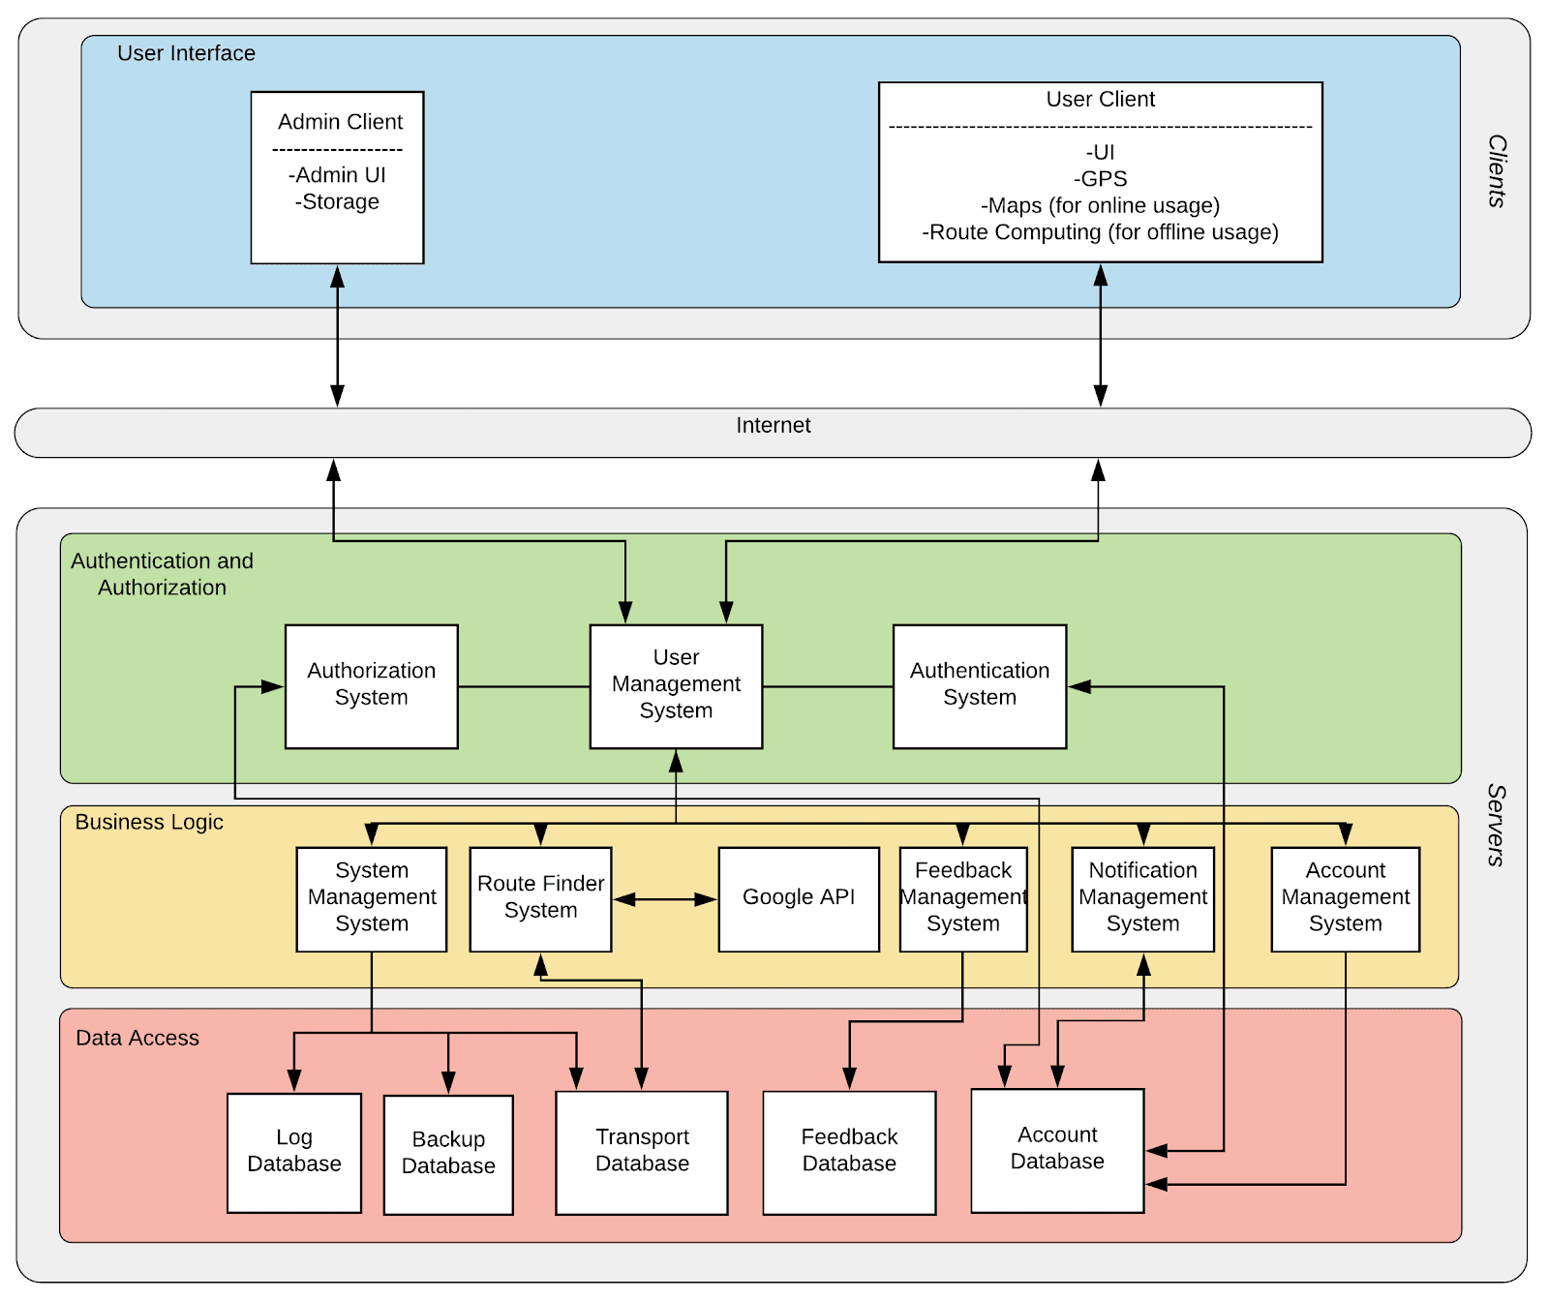
SYSTEM ARCHITECTURE

Slide 8
SYSTEM ARCHITECTURE (cont.)
Servers are distributed around the globe. So there can be multiple servers for any given server type.
Our system offers offline usage as well (provided that user has already downloaded the necessary packages beforehand). In case of offline usage, everything can be done within client-side. But offline usage itself has downsides such as possible out-of-date data, not being able to take traffic into calculation and so on.

Slide 9
USER INTERFACE DESIGN CONSIDERATIONS
We tried not to use too many different colours on a single page. Since, as we’ve discussed in the class, it can be distracting.
We tried to keep things simple and minimalistic because our customers have way too diverse backgrounds and because of this we believe that less is more.

Slide 10
testıng
Since only two parts of our system has been implemented, we could not make any system testing. However we indeed did some testings for the implemented parts of our system. We’ve done some ad-hoc testing and did some GUI testing (without using any automation tool). We’ve also did two very simple unit tests.

Slide 11
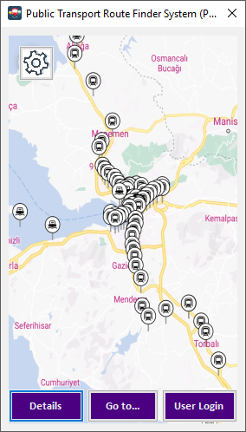
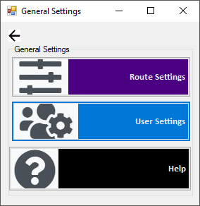
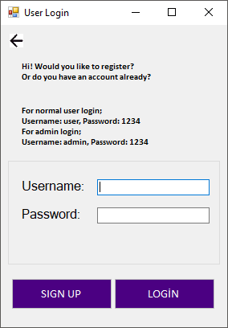
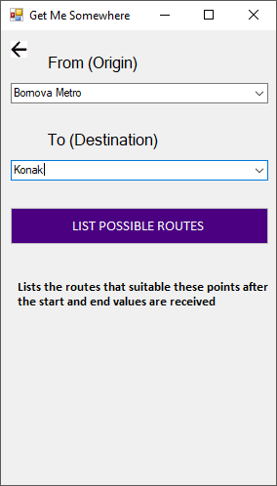
A few screenshots from the applıcatıon

Slide 12
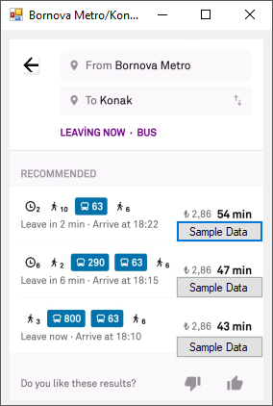
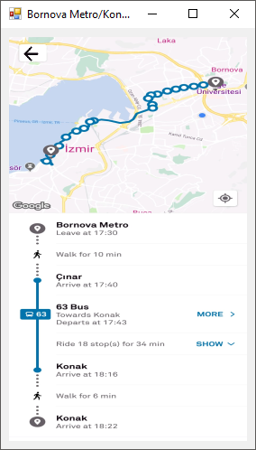
A few screenshots from the applıcatıon (cont.)

Slide 13
SOURCE CODE
Source code of the application can be found at: https://drive.google.com/file/d/1K1hl_Q9FOkMxoI3WRZjmhAo8Cf7MK5P7/view?usp=sharing

